Slide 1
Lecture 10: Virtualizing Memory – Segmentation and Paging

Slide 2
The Course Organization (Bottom-up)
Race Conditions, Lock/Semaphore
Concurrency
Thread
Memory Management
HW#4
Virtualization
Process and CPU Scheduling
HW#3
IO Devices and Storage
HW#2
&
Project
Persistence
File System
System Calls (User-level Programming)
HW#1

Slide 3
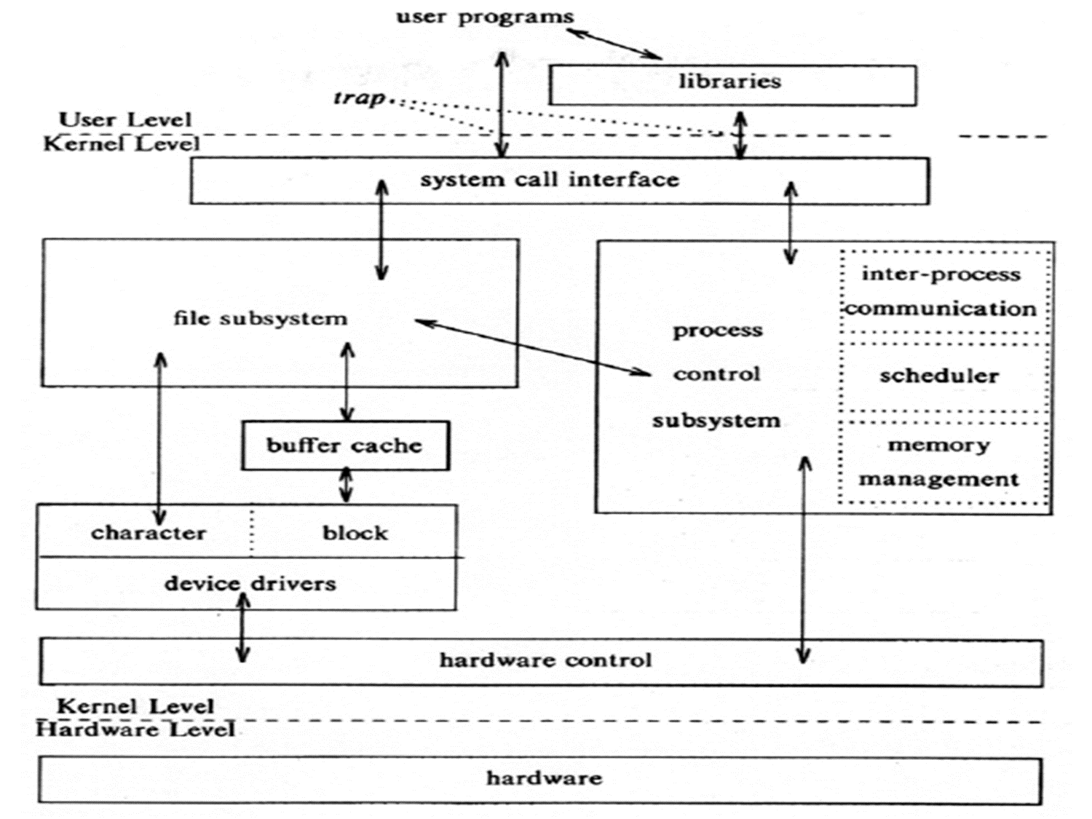
OS – Resource management via virtualization
OS provides services via System Call (typically a few hundred) to run process, access memory/devices/files, etc.
The OS manages resources such as CPU, memory and disk via virtualization.
many programs to run (processes) → Sharing the CPU
many processes to concurrently access their own instructions and data → Sharing memory
many processes to access devices → Sharing disks
The Design Of The Unix Operating System (Maurice Bach, 1986)

Slide 4
Part I: Segmentation

Slide 5
Inefficiency of the Base and Bound Approach
0KB
Program Code
Big chunk of “free” space
“free” space takes up physical memory.
Hard to run when an address space does not fit into physical memory
1KB
2KB
3KB
4KB
5KB
Heap
6KB
(free)
14KB
15KB
Stack
16KB

Slide 6
Segmentation
Segment is just a contiguous portion of the address space of a particular length.
Logically-different segment: code, stack, heap
Each segment can be placed in different part of physical memory.
Base and bounds exist per each segment.

Slide 7
Placing Segment In Physical Memory
0KB
Operating System
16KB
(not in use)
Segment Base Size
Code 32K 2K
Heap 34K 2K
Stack 28K 2K
Stack
(not in use)
32KB
Code
Heap
(not in use)
48KB
64KB
Physical Memory

Slide 8

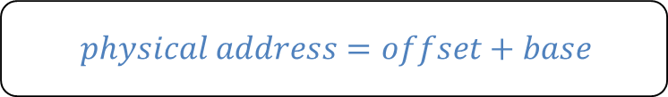
Address Translation on Segmentation
The offset of virtual address 100 is 100.
The code segment starts at virtual address 0 in address space.
$$physical address=offset+base$$
Segment Base Size
Code 32K 2K
16KB
(not in use)
0KB
32KB
$100+32K or 32868$ is the desired physical address
100
Program Code
Code
instruction
2KB
34KB
Heap
4KB
(not in use)

Slide 9

Address Translation on Segmentation(Cont.)
The offset of virtual address 4200 is 104.
The heap segment starts at virtual address 4096 in address space.
$Virtual address+base$ is not the correct physical address.
Segment Base Size
Heap 34K 2K
(not in use)
32KB
Code
4KB
34KB
$104+34K or 34920$ is the desired physical address
4200
Heap
Heap
data
6KB
36KB
(not in use)
Address Space
Physical Memory

Slide 10
Segmentation Fault or Violation
If an illegal address such as 7KB which is beyond the end of heap is referenced, the OS occurs segmentation fault.
The hardware detects that the address is out of bounds.
4KB
Heap
6KB
7KB
(not in use)
8KB
Address Space

Slide 11
Referring to Segment
Explicit approach
Chop up the address space into segments based on the top few bits of virtual address.
Example: virtual address 4200 (01000001101000)
13
12
11
10
9
8
7
6
5
4
3
2
1
0
Segment
Offset
Segment bits
Code 00
Heap 01
Stack 10
- 11
13
12
11
10
9
8
7
6
5
4
3
2
1
0
0
1
0
0
0
0
0
1
1
0
1
0
0
0
Segment
Offset

Slide 12
Referring to Segment(Cont.)
SEG_MASK = 0x3000(11000000000000)
SEG_SHIFT = 12
OFFSET_MASK = 0xFFF (00111111111111)
1 // get top 2 bits of 14-bit VA
2 Segment = (VirtualAddress & SEG_MASK) >> SEG_SHIFT
3 // now get offset
4 Offset = VirtualAddress & OFFSET_MASK
5 if (Offset >= Bounds[Segment])
6 RaiseException(PROTECTION_FAULT)
7 else
8 PhysAddr = Base[Segment] + Offset
9 Register = AccessMemory(PhysAddr)

Slide 13
Referring to Stack Segment
Stack grows backward.
Extra hardware support is need.
The hardware checks which way the segment grows.
1: positive direction, 0: negative direction
Segment Register(with Negative-Growth Support)
(not in use)
Segment Base Size Grows Positive?
Code 32K 2K 1
Heap 34K 2K 1
Stack 28K 2K 0
26KB
Stack
28KB
(not in use)
Physical Memory

Slide 14
Support for Sharing
Segment can be shared between address space.
Code sharing is still in use in systems today.
by extra hardware support.
Extra hardware support is need for form of Protection bits.
A few more bits per segment to indicate permissions of read, write and execute.
Segment Register Values(with Protection)
Segment Base Size Grows Positive? Protection
Code 32K 2K 1 Read-Execute
Heap 34K 2K 1 Read-Write
Stack 28K 2K 0 Read-Write

Slide 15
Fine-Grained and Coarse-Grained
Coarse-Grained means segmentation in a small number.
e.g., code, heap, stack.
Fine-Grained segmentation allows more flexibility for address space in some early system.
To support many segments, Hardware support with a segment table is required.

Slide 16
OS support: Fragmentation
External Fragmentation: little holes of free space in physical memory that make difficulty to allocate new segments.
There is X KB free, but not in one contiguous segment.
The OS cannot satisfy the X KB request.
Compaction: rearranging the exiting segments in physical memory.
Compaction is costly.
Stop running process.
Copy data to somewhere.
Change segment register value.

Slide 17
Memory Compaction
Not compacted
Compacted
0KB
Operating System
0KB
Operating System
8KB
8KB
16KB
16KB
(not in use)
Allocated
24KB
24KB
Allocated
32KB
32KB
(not in use)
40KB
Allocated
40KB
(not in use)
48KB
(not in use)
48KB
56KB
56KB
Allocated
64KB
64KB

Slide 18
Part II: Paging

Slide 19
Concept of Paging
Paging splits up address space into fixed-sized unit called a page.
Segmentation: variable size of logical segments(code, stack, heap, etc.)
With paging, physical memory is also split into some number of pages called a page frame.
Page table per process is needed to translate the virtual address to physical address.

Slide 20
Paging
P1
P2
P3
Virt Mem
Phys Mem

Slide 21
Fill in Page Table
P1
P2
P3
Virt Mem
Phys Mem
0
1
2
3
4
5
6
7
8
9
10
11
P1
P2
P3
3
0
8
Page Tables:
1
4
5
7
2
9
10
6
11

Slide 22
Advantages Of Paging
Flexibility: Supporting the abstraction of address space effectively
Don’t need assumption how heap and stack grow and are used.
Simplicity: ease of free-space management
The page in address space and the page frame are the same size.
Easy to allocate and keep a free list

Slide 23
Example: A Simple Paging
128-byte physical memory with 16 bytes page frames
64-byte address space with 16 bytes pages
0
page frame 0 of physical memory
reserved for OS
16
(unused)
page frame 1
0
32
(page 0 of the address space)
page 3 of AS
page frame 2
16
48
(page 1)
page 0 of AS
page frame 3
32
64
(page 2)
(unused)
page frame 4
48
(page 3)
80
page 2 of AS
page frame 5
64
A Simple 64-byte Address Space
96
(unused)
page frame 6
112
page 1 of AS
page frame 7
128
64-Byte Address Space Placed In Physical Memory

Slide 24
Address Translation
Two components in the virtual address
VPN: virtual page number
Offset: offset within the page
Example: virtual address 21 in 64-byte address space
VPN
offset
Va5
Va4
Va3
Va2
Va1
Va0
VPN
offset
0
1
0
1
0
1

Slide 25
Example: Address Translation
The virtual address 21 in 64-byte address space
VPN
offset
Virtual
Address
0
1
0
1
0
1
Address Translation
Physical
Address
1
1
1
0
1
0
1
PFN
offset

Slide 26
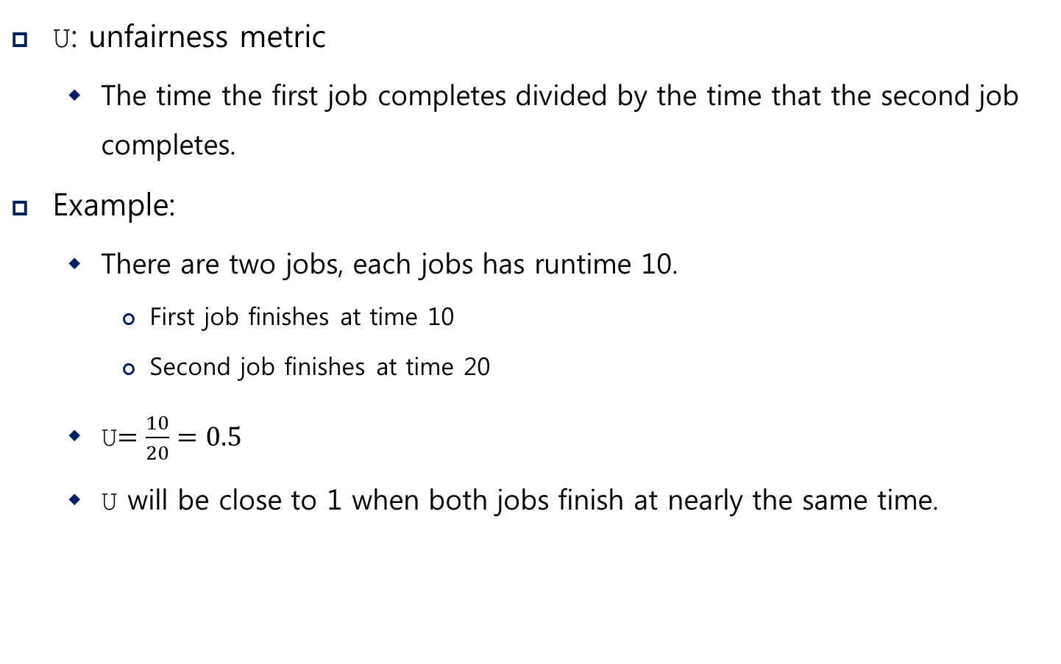
Where Are Page Tables Stored?
Page tables can get awfully large
32-bit address space with 4-KB pages, 20 bits for VPN
${4MB= 2}^{20} entries ∗4 Bytes per page table entry$
Page tables for peach process are stored in memory.

Slide 27
Example: Page Table in Kernel Physical Memory
0
page table
3 7 5 2
page frame 0 of physical memory
16
(unused)
page frame 1
32
page 3 of AS
page frame 2
48
page 0 of AS
page frame 3
64
(unused)
page frame 4
80
page 2 of AS
page frame 5
96
(unused)
page frame 6
112
page 1 of AS
page frame 7
128
Physical Memory

Slide 28
What is in the page table?
The page table is just a data structure that is used to map the virtual address to physical address.
Simplest form: a linear page table, an array
The OS indexes the array by VPN, and looks up the page-table entry.

Slide 29
Common Flags Of Page Table Entry
Valid Bit: Indicating whether the particular translation is valid.
Protection Bit: Indicating whether the page could be read from, written to, or executed from
Present Bit: Indicating whether this page is in physical memory or on disk(swapped out)
Dirty Bit: Indicating whether the page has been modified since it was brought into memory
Reference Bit(Accessed Bit): Indicating that a page has been accessed

Slide 30
Example: x86 Page Table Entry
P: present
R/W: read/write bit
U/S: supervisor
A: accessed bit
D: dirty bit
PFN: the page frame number
31 | 30 | 29 | 28 | 27 | 26 | 25 | 24 | 23 | 22 | 21 | 20 | 19 | 18 | 17 | 16 | 15 | 14 | 13 | 12 | 11 | 10 | 9 | 8 | 7 | 6 | 5 | 4 | 3 | 2 | 1 | 0
PFN
G
PAT
D
A
PCD
PWT
U/S
R/W
P
An x86 Page Table Entry(PTE)

Slide 31
Paging: Too Slow
To find a location of the desired PTE, the starting location of the page table is needed.
For every memory reference, paging requires the OS to perform one extra memory reference.

Slide 32
Accessing Memory With Paging
1 // Extract the VPN from the virtual address
2 VPN = (VirtualAddress & VPN_MASK) >> SHIFT
3
4 // Form the address of the page-table entry (PTE)
5 PTEAddr = PTBR + (VPN * sizeof(PTE))
6
7 // Fetch the PTE
8 PTE = AccessMemory(PTEAddr)
9
10 // Check if process can access the page
11 if (PTE.Valid == False)
12 RaiseException(SEGMENTATION_FAULT)
13 else if (CanAccess(PTE.ProtectBits) == False)
14 RaiseException(PROTECTION_FAULT)
15 else
16 // Access is OK: form physical address and fetch it
17 offset = VirtualAddress & OFFSET_MASK
18 PhysAddr = (PTE.PFN << PFN_SHIFT) | offset
19 Register = AccessMemory(PhysAddr)

Slide 33
Summary
Segmentation
A program contains logically-different segments: code, stack, heap
Each segment can be placed in different part of physical memory.
Base and bounds exist per each segment.
Paging
physical memory is split into some number of pages called a page frame.
Page table per process is used to translate the virtual address to physical address.
Next: Free Space Management, Translation Lookaside Buffers, Advanced Page Tables, and Swapping (Chapters 17, 19, 20, 21, 22, 23)

